Slide 1
PMP (Project Management Plan)
Purpose of Project
“Create a working learning management system capable of distributing quizzes to students, collecting student responses to quizzes, generate statistical data on those quizzes and track attendance”
Contents presented in PMP:
Work Activities
Schedule Allocation (Effort Breakdown, Critical Path Diagram, and Gantt Chart)
Iteration Goals
Breakdown of Work Activities

Slide 2
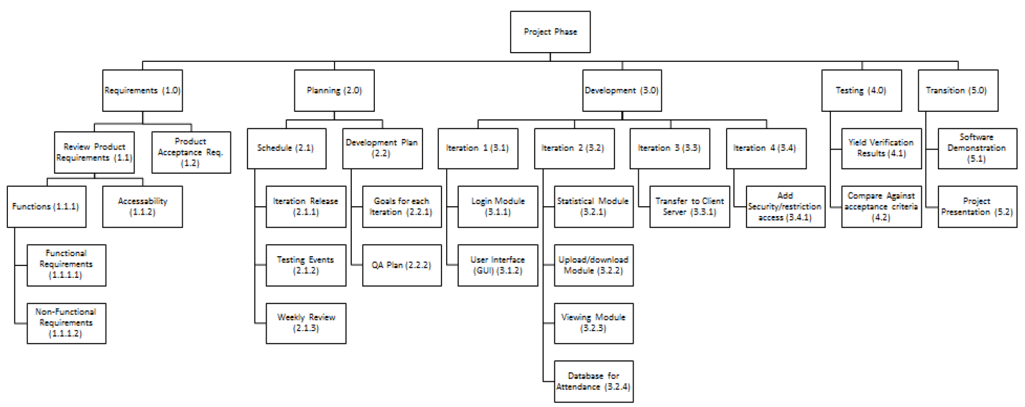
Contents of PMP
Work Activities

Slide 3
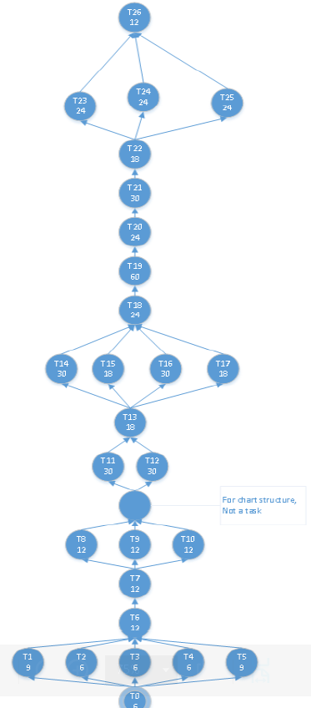
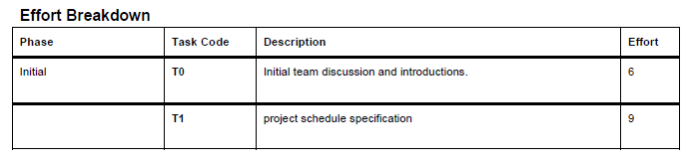
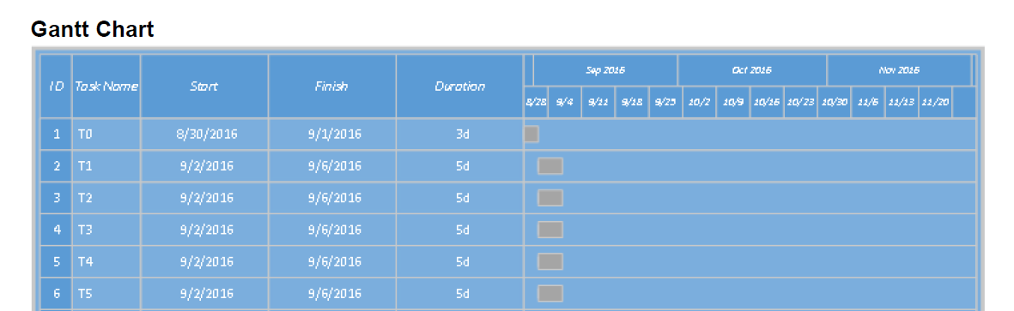
Contents of PMP
Schedule Allocation

Slide 4
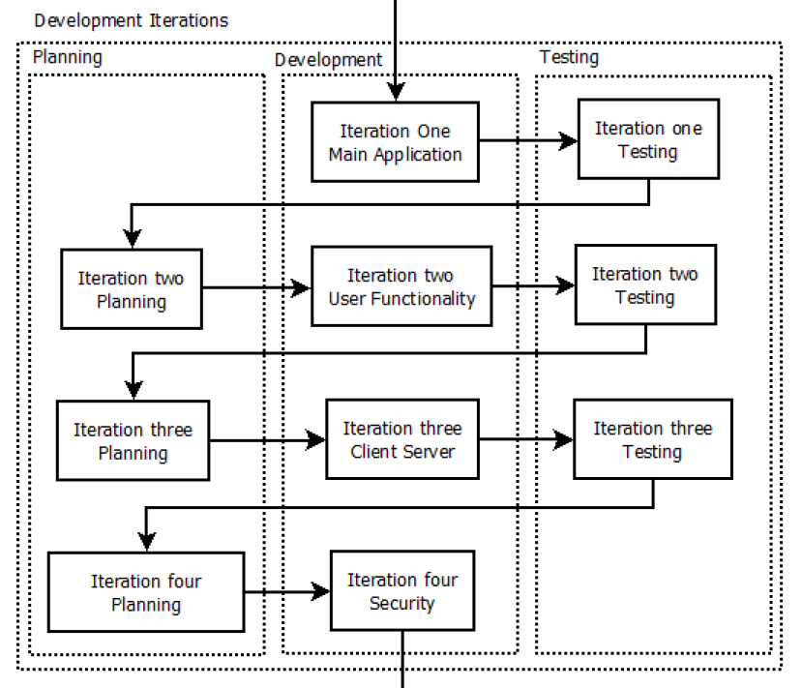
Contents of PMP
Iteration Goals

Slide 5
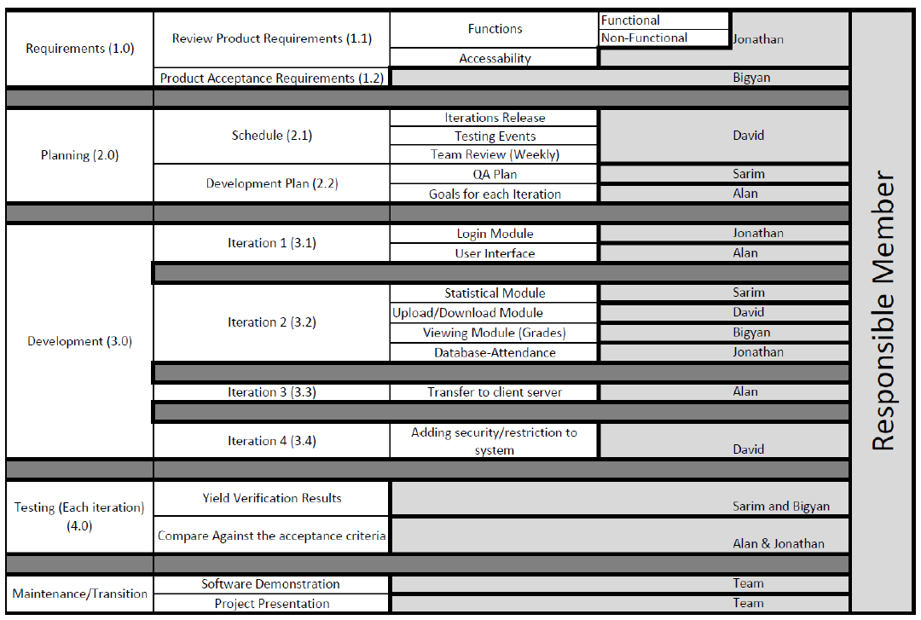
Contents of PMP
Breakdown of Work Activities

Slide 6
SRS (Software Requirements Specifications)
Purpose: “To describe the software system that will be developed for the application.”
Software Requirements, Constraints and Limitations
User Interface
Software Interface
Communication Interface
Operations in the Application
Product Functions
User Characteristics
Constraints
Software System Attributes

